Slide 1

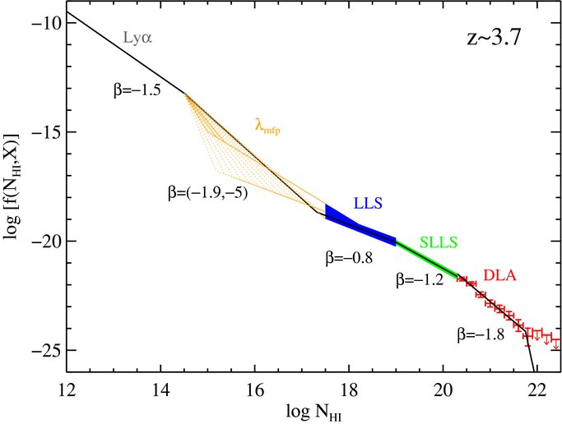
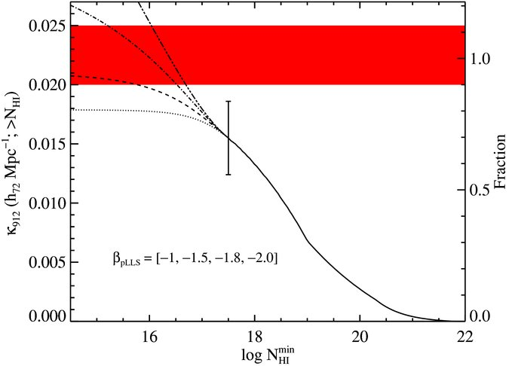



The Partial Project: An XQ-100 Survey of pLLSs at z ~ 3
Joseph Ribaudo¹, J. X. Prochaska², J. O’Meara³, & XQ-100 Survey Team⌘
¹Utica College, ²University of California at Santa Cruz, & ³Saint Michael’s College
Survey Goals:
Determine statistical properties of the population of absorbers with log NHI>16.8
Estimate the contribution of pLLSs to the mean free path for ionizing radiation at z~3
Characterize the chemical composition and physical properties of the gas giving rise to pLLSs
Using the XQ-100 dataset of VLT/X-Shooter spectra, we present the design of a statistical study of partial Lyman limit systems (pLLSs) at z~3, providing insight into the properties and characteristics of the optically-thin circumgalactic medium (CGM) over this epoch. These systems contribute significantly to the mean free path for ionizing radiation in the z~3 universe and probe the enriched CGM on (presumed) scales of tens to hundreds of kpc. The high-quality observations (S/N~20 and R~10,000) give rise to a log NHI detection limit of 16.8, allowing our study to place the strongest constraints to date on the population of pLLSs at z~3.
Figure 3: A representative sample of the XQ-100 spectra being used in this survey. The QSO rest-frame Lyman limit is shown with the vertical red line.
Figure 1: The pLLSs are identified through the drop in QSO flux at 912Å in the rest-frame of the absorbing gas. The reliability and detection limits of the fitting routine were tested with the analysis of mock QSO spectra with artificial pLLSs present, as shown above. Note the continuum placement above, shown with the dashed line. The robust flux calibration of the XQ-100 spectra provide strong constraints on the minimum flux level of the QSO continuum. Using the mock spectra we were able to recover ~100% of the log NHI>16.8 systems, with a false detection rate in this regime of 0%.
Figure 2: The population of pLLSs at z~3 is poorly constrained, as highlighted by the frequency distribution plot of HI absorbers (top, pink). The Partial Project will provide significant constraints on the number density and frequency distribution of pLLSs, allowing for direct estimates for the contribution to the mean free path of hydrogen ionizing photons (bottom, grey). In these plots, β is the frequency distribution parameter from the power-law form:
See Prochaska et al. (2010) for details.
Figure 4: The number of QSOs in the XQ-100 sample with spectral coverage of the HI Lyman-limit at a given redshift (known as g(z)). The redshift coverage of our sample peaks at z~3.5.
⌘ XQ-100 Survey:
The XQ-100 Survey consists of 100 z>3.5 QSO spectra taken with X-Shooter at the ESO VLT. For details see:
http://adlibitum.oats.inaf.it/XQ100survey/
Contact Information:
jsribaud@utica.edu
http://www.utica.edu/faculty_staff/jribaudo/
@AstRoboto
References:
Prochaska, J. X., O’Meara, J., Worseck, G. 2010, ApJ, 718, 392

